Slide 1
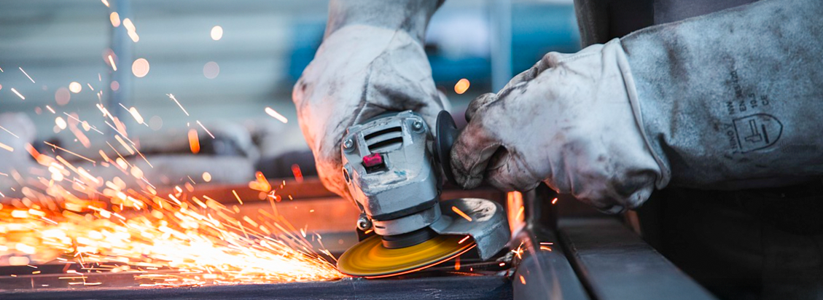
Toolbox Machine safety: Working with the angle grinder
Company name and date

Slide 2

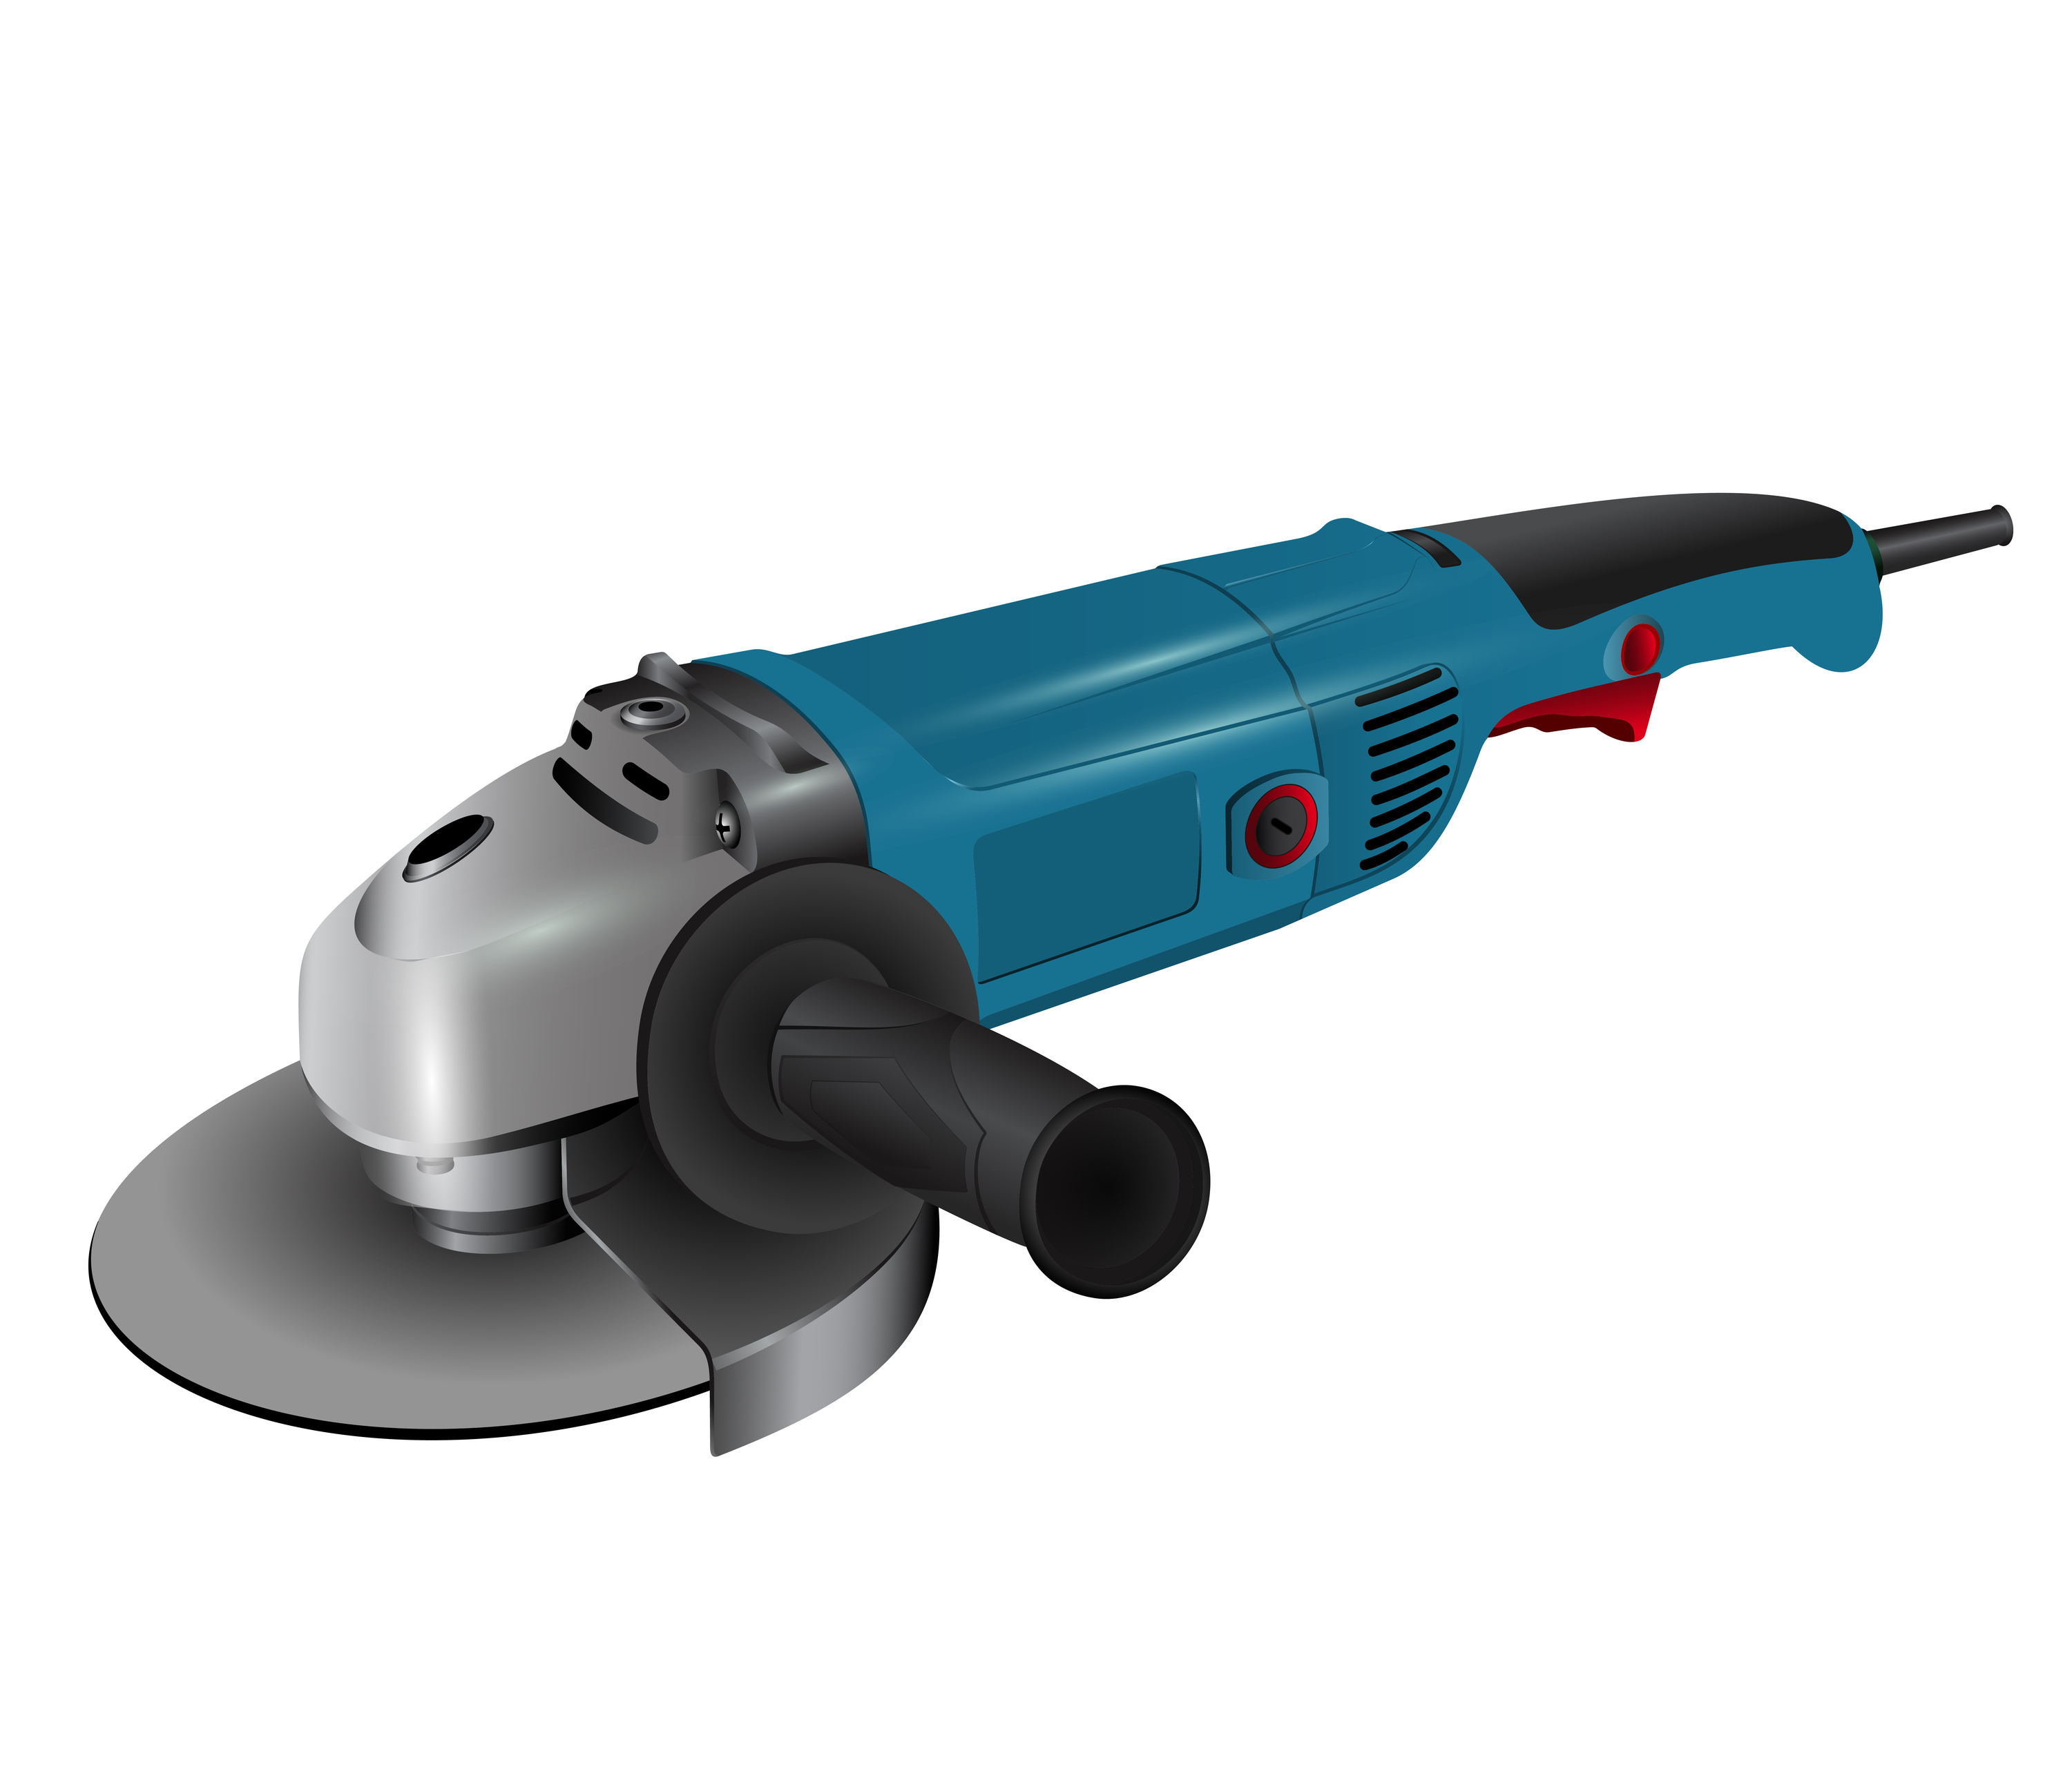
Angle grinder
Safe and healthy working practices | Machine safety: Angle grinder
Versatile power tool for:
Grinding > grinding disc
Deburring > Deburring/flap disc
Sanding > Sanding/flap disc
Affordable, handy and easy to operate, Frequently used both commercially and for private DIY jobs.

Slide 3
Safe and healthy working practices | Machine safety: Angle grinder
Not so flex!
Unfortunately, the angle grinder is not as harmless as it seems.
Approximately 60% of incidents involving an angle grinder result in accidents.
Hand injuries are one of the most common. But flying particles also cause injuries, often to the face and eyes.
The disc jamming can easily cause a sprain. And what about the fire hazard caused by hot sparks and smouldering embers?
These are very common consequences of incorrect use of an angle grinder.
Notes:
https://www.nlarbeidsinspectie.nl/publicaties/rapporten/2024/08/26/monitor-arbeidsongevallen-2023
The accident type "Contact with work equipment or object" is common in the Industrial sector (42% of accidents in that sector). The majority of accidents involve accidents in which the victim came into contact with moving parts of a machine (69%).

Slide 4
Safe and healthy working practices | Machine safety: Angle grinder
Angle grinder
Here are a few simple but important points about the safe use of angle grinders.
Before you start:
Check the device and the cord. Is everything still secure and is there any visible damage?
Leave the protective cover and handle in place. Or reattach them.
DO NOT WORK WITHOUT THE PROTECTIVE COVER AND HANDLE
Make sure that the grinding disc is securely attached and suitable for the material you are going to be working on.

Slide 5
Safe and healthy working practices | Machine safety: Angle grinder
Grinding disc: no disc, no result
Grinding discs are designed for specific applications and materials.
Common types:
Cutting discs: for (right-angle) cutting of material. Thickness from 1 mm.
Deburring discs: with recessed centre, ideal for grinding at an angle. Thickness 6-7 mm.
Flap discs: with overlapping abrasive sheets, suitable for removing rust and paint and “contouring” workpieces.
Sanding discs (fibre discs): to be mounted on a backing pad. Varied grit size.
Notes:
https://www.nlarbeidsinspectie.nl/publicaties/rapporten/2024/08/26/monitor-arbeidsongevallen-2023
The accident type "Contact with work equipment or object" is common in the Industrial sector (42% of accidents in that sector). The majority of accidents involve accidents in which the victim came into contact with moving parts of a machine (69%).

Slide 6

The grinding disc contains (legally required) a lot of information.
Safe and healthy working practices | Machine safety: Angle grinder
Pictures say more than words

Slide 7
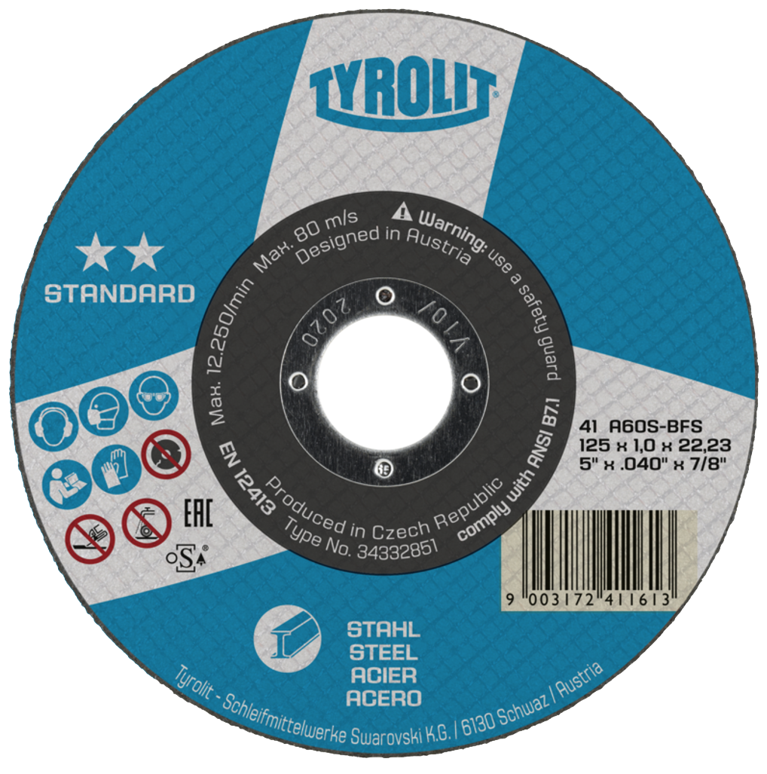
Legal markings on grinding discs:
Safe and healthy working practices | Machine safety: Angle grinder
Seeing is knowing
Manufacturer name
Expiry date, year and quarter (on the steel ring)
Maximum permissible speed
Type of binder
Grit size
Structure
Hardness
Grinding disc dimensions
Material application

Slide 8
If the manufacturer says so, then these are the minimum requirements. Your employer may impose additional requirements. In both cases, you must comply.
Safe and healthy working practices | Machine safety: Angle grinder
Pictures say more than words...
Wear hearing protection (hearing damage occurs after just 3 minutes)
Wear respiratory protection (dust from the product and grinding disc)
Wear suitable face protection
Wear gloves
Read the manual

Slide 9
Safe and healthy working practices | Machine safety: Angle grinder
What is not allowed?
The manufacturer indicates what is not allowed. Familiarise yourself with the meaning of your discs.
Using a disc that is older than the date on the ring. Not allowed!
The pictograms say it all:
No deburring
No wet grinding
Do not use if the disc is damaged

Slide 10
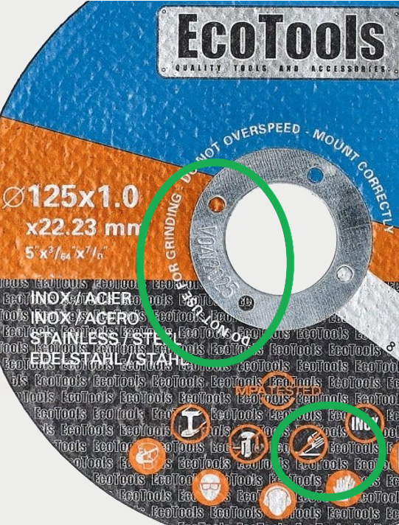
Safe and healthy working practices | Machine safety: Angle grinder
How can I tell the difference?
The main difference between cutting discs and deburring discs is their thickness.
Whereas a cutting disc is often approx. 1 mm thick, a deburring disc is thicker.
In this example, a warning is given not to use this disc for deburring. This is indicated by a pictogram and text.
Text
Pictogram

Slide 11
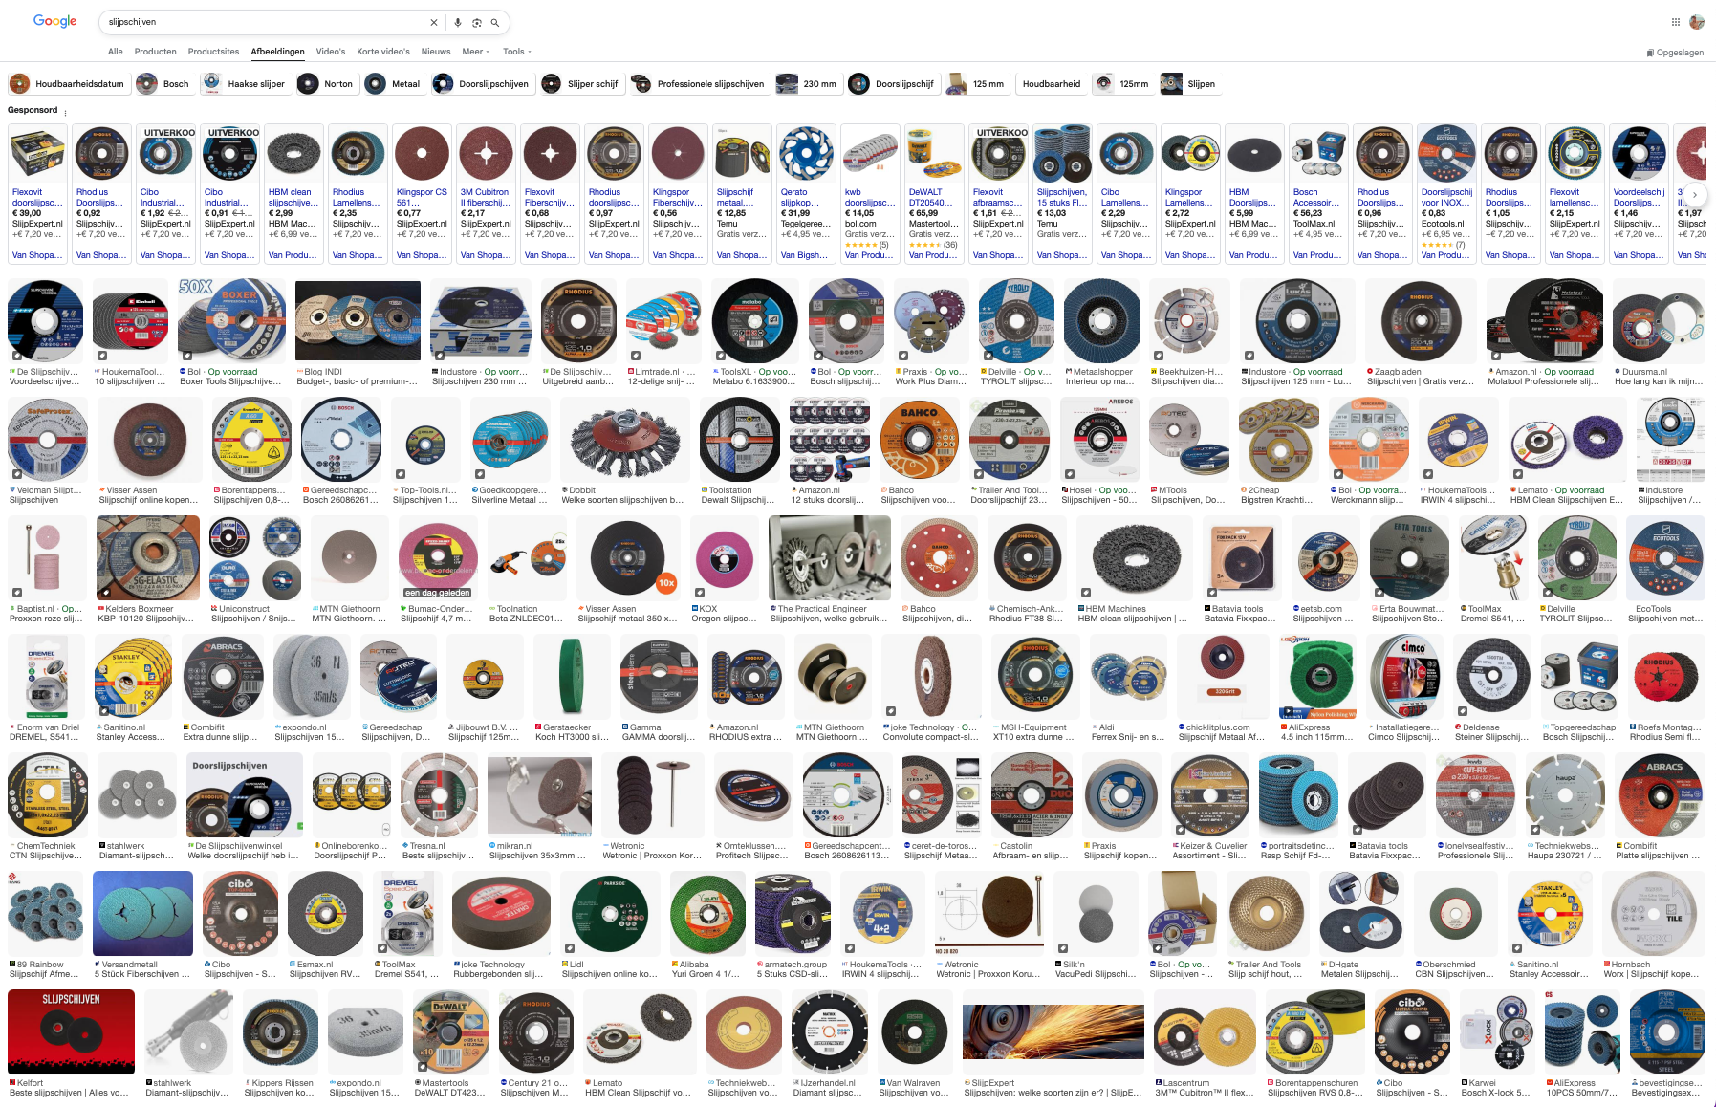
Safe and healthy working practices | Machine safety: Angle grinder
Choice stress
Before you start, you need to decide which disc you want to use.
The task and the material to be ground determine which disc you should choose.
If you don't think carefully and just use any disc, this can lead to poor results and injury.
The choice is huge (source: Google)

Slide 12
Safe and healthy working practices | Machine safety: Angle grinder
Safe operation
Keep the plug out of the socket until...
The grinding disc is securely fastened and suitable for the material you are working on.
Secure your workpiece firmly to prevent unexpected movements.
Now you can plug it in (if the “ON” button is still off).
Hold the grinder with both hands, as this gives you more control over it. Take a stable position and start the grinder.
Allow the grinder to reach speed before you start grinding.

Slide 13
Safe and healthy working practices | Machine safety: Angle grinder
Safe operation
Not every disc is suitable for deburring, so make sure you use a suitable deburring disc and maintain the correct angle.
Cutting through: when cutting through with a thin disc, be careful not to make any sudden movements; keep the angle as perpendicular as possible. A thin disc can easily shatter,
with all the consequences that entails.
When you have finished grinding or your grinding disc needs replacing, wait until your angle grinder has come to a complete standstill and first unplug it from the mains.
Never replace or change your disc while the machine is still powered up.

Slide 14
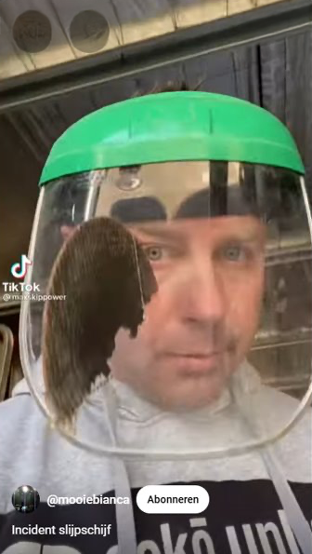
Safe and healthy working practices | Machine safety: Angle grinder
Safe operation
By carefully reading the information on the device and the grinding disc, you now know that its use involves risks.
Your common sense also tells you to stay away from the rotating disc. Ensure that you grind in a controlled manner so that the disc remains intact.
It remains a useful device, but how much risk are you willing to take?
Don’t be lax and work safely with an angle grinder!

Slide 15

Safe and healthy working practices | Machine safety: Angle grinder
Is grinding difficult?
NO, certainly not, but that is precisely
why it is so easy to make mistakes.

Slide 16

Safe and healthy working practices | Machine safety: Angle grinder
Questions?
info@5xbeter.nl | www.5xbeter.nl

Slide 17
Safe and healthy working practices | Machine safety: Angle grinder
Need help?
Discuss it with your manager or contact the health and safety officer.
Consult an Improvement Coach from 5xbeter: www.5xbeter.nl
Or call the FREE Improvement Line: 0800 – 55 55 005
info@5xbeter.nl | www.5xbeter.nl

